Slide 1
Unit –II:Time Response Analysis
What is the need????
Since time is used as an independent variable in most control
systems, it is usually of interest to evaluate the state and output
responses with respect to time.
In most control system problems, the final evaluation of the
performance of the system is based on the time response.
Definition: The time response of a control system may be defined
as the analysis of the behavior of a system in accordance with time
when a specified input test signal is applied.

Slide 2
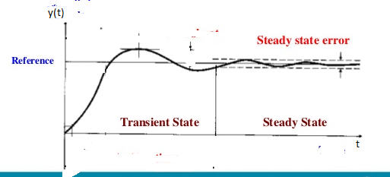
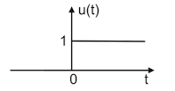
Contd…..
The time response of a control system is usually divided into two parts:
transient response
steady state response
(a) Input signal
(b) Output Response

Slide 3
Contd…..
Let,
yt) denote the time response of a system, then
y(t) = y_{t}(t) + y_{ss}(t)
where,
y_{t}(t) = transient response
y_{ss}(t) = steady state response
Transient Response: Transient response is defined as the part of the time response
that goes to zero as time becomes very large
Lim y_{t}(t) = 0
t→∞

Slide 4
Contd…..
Steady State Response: Steady state response is defined as the part of the time response that remains after the transients has died. Thus, the response can still vary,
But in a fixed pattern – sine wave or ramp function.

Slide 5
Standard Input Signals
For the purpose of analysis and design, it is always necessary to assume some
basic types of test signals so that the performance of a system can be evaluated.
Some basic standard test signals are
Step function ( signifies a sudden change)
Ramp function ( signifies a constant velocity)
Parabolic function ( signifies a constant acceleration)
Impulse function ( signifies a momentary shock)

Slide 6
Contd…..
Step function : The step function input represents an instantaneous change
in the input signal.
The mathematical representation
of a step function of magnitude A is
u(t)
A
0
t
Note:
If A=1, the step signal is called unit step signal
Laplace transform of step function is
3. Step function is called displacement function

Slide 7
Contd…..
Ramp function : Ramp function is defined as gradual application of input, as shown in figure.
r(t)
The mathematical representation
of a ramp function of magnitude A is
0
t
Note:
If A=1, then r(t) = t, the ramp function is called unit ramp signal

Slide 8
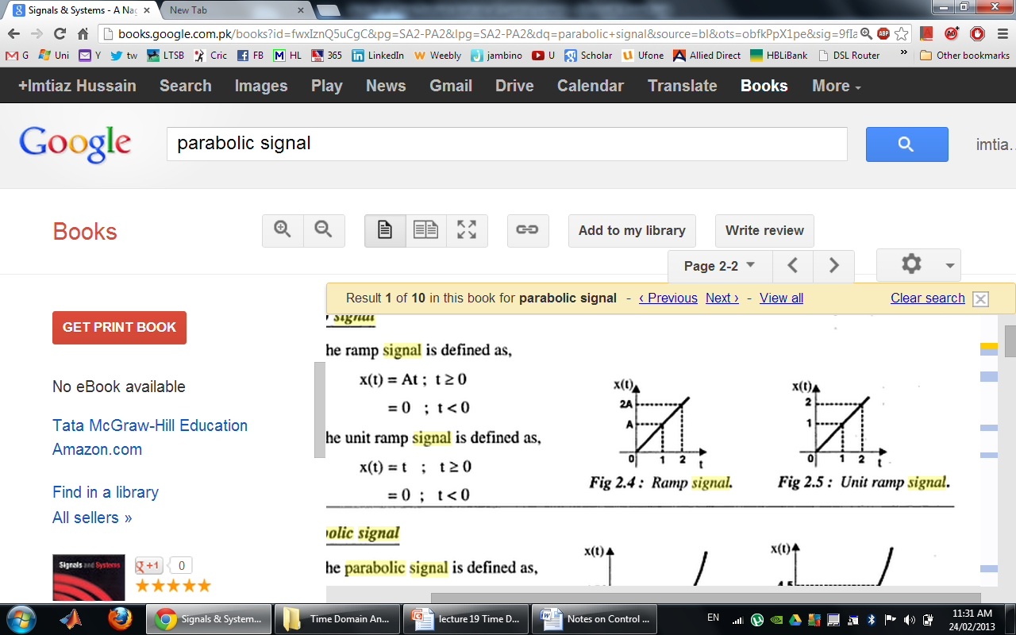
Contd…..
2. Laplace transform of ramp function is
3. Ramp function is also called velocity function
Illustration:
r(t)
r(t)
ramp signal with slope A
unit ramp signal

Slide 9
Contd…..
3. Parabolic function : Parabolic function represents a function that is one order faster than a ramp function.
r(t)
The mathematical representation
of a parabolic function of magnitude A is
0
t
Note:
If A=1, then r(t) = t²/2 , the parabolic function is called unit parabolic function

Slide 10
Contd…..
2. Laplace transform of parabolic function is
3. Parabolic function is also called acceleration function

Slide 11
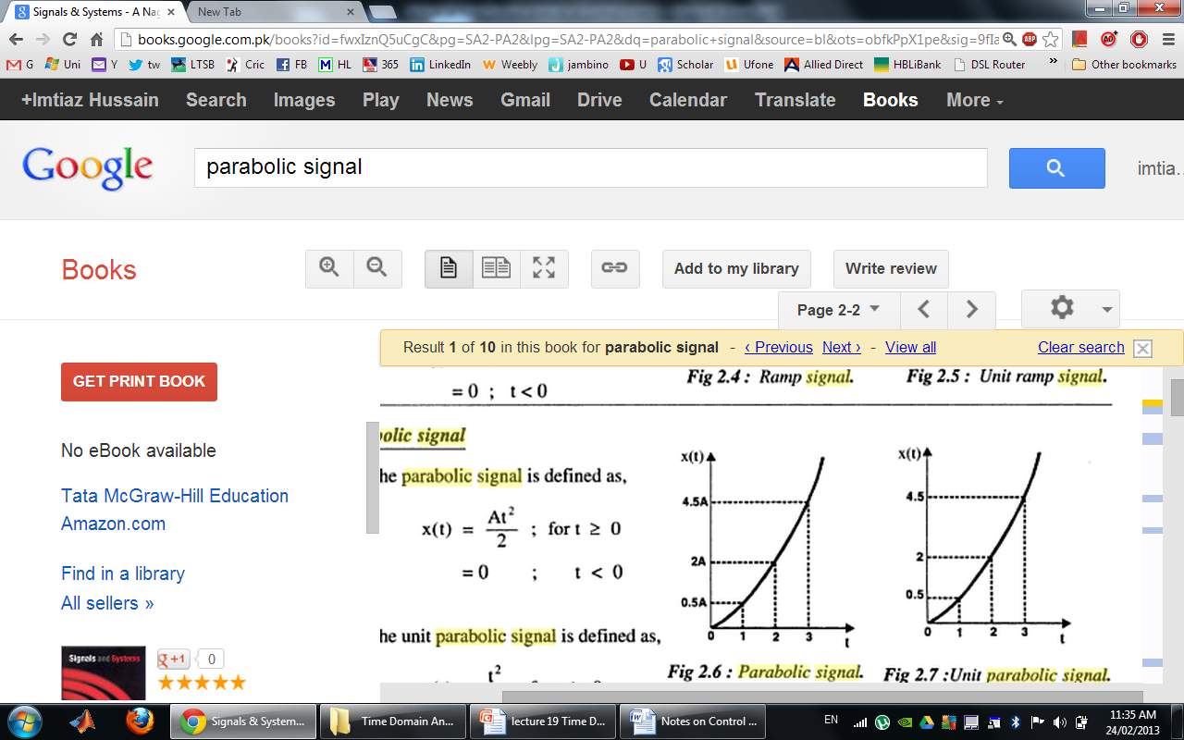
Contd…..
p(t)
Illustration:
parabolic signal with slope A
p(t)
Unit parabolic signal

Slide 12
Contd…..
4. Impulse function : Impulse function represents a sudden shock characteristic of input signal
δ(t)
The mathematical representation
of a impulse function of magnitude A is
A
0
t

